Slide 1


Data Science
Capstone
CAPSTONE TOPIC : Logistic Regression for Business Survival on the San Diego County Business Listing Dataset.
PRESENTED BY: KENIER RAMIREZ
DATE: 12/19/2025

Slide 2
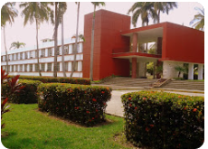

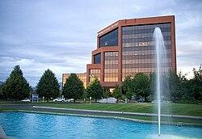

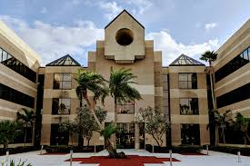

About me
Bachelors of Science in Mathematics (Earned on July , 2014),
Central University “Marta Abreu” of Las Villas. Statistics Instructor in the same institution (2014-2017). Cuba
Pursuing M.S. in Data Analytics (Feb-Dec, 2025),
Western Governors University. United States
Experience in Statistical Data Analysis and in Teaching (since September,2014).
Currently, AP Statistics Teacher. United States

Slide 3


Dataset Details
Registered Businesses: 158,330 (since 1926).
Relevant Variables: Geographic location, businesses info, etc.
Main Focus: Find a predictive business survival model.
Scenario
Develop a predictive model that estimates the likelihood of business survival, providing entrepreneurs and investors with data-driven insights to support informed businesses expansion decisions.
Main Goal
Apply logistic regression modeling to the San Diego County Business Listings dataset to identify statistically significant predictors of business survival and to evaluate the feasibility of constructing an accurate and interpretable predictive model.

Slide 4






Can a logistic regression model be constructed on the San Diego County Business Listings dataset to estimate the likelihood of business survival?
San Diego County Businesses Survival Analysis Cycle
Data Collection & Cleaning
(San Diego County Business dataset)
Exploratory Data Analysis (Dashboard)
Can a logistic regression model be constructed on the San Diego County Business Listings dataset to estimate the likelihood of business survival?
Presenting Findings
(Report)
Statistical Data Analysis
(Hypothesis Tests & Clustering)
•Null Hypothesis (H0): A predictive parametric logistic regression model cannot be constructed from the research dataset at or above a benchmark performance threshold of an F1-Score of 0.70 .
•Alternative Hypothesis (H1): A predictive parametric logistic regression model can be constructed from the research dataset achieving an F1-Score of 0.70 or higher
Modeling & Deployment
(Predictive Models)

Slide 5
Data Collection
The data used in this study was the integration of three primary public data sources: the City of San Diego's Active and Inactive Business Listings datasets (City of San Diego, n.d.) and the 2020 Census ZIP Code–level population dataset compiled by the San Diego Association of Governments (SANDAG, n.d.). The final dataset contains 158,330 registered businesses established between 1926, and November 3, 2025.
Each record includes key variables such as account creation date, business start date, ownership type, NAICS sector and code, city, ZIP code, latitude, longitude, population, and the response variable account_status, which indicates whether a business is active or inactive. Several derived variables were also generated to support the analysis, including business age, business life-cycle groupings, local business density, and active/closed rates by ZIP code, NAICS sector, or city. These derived measures align with accepted practices in multivariate analysis and predictive modeling.
An important advantage of this data-gathering methodology is that the dataset draws from reputable, publicly maintained sources, ensuring transparency, accessibility, and consistent documentation. Because it integrates three independently curated datasets, it provides both business-level detail and contextual demographic information, supporting a more comprehensive modeling framework.
However, the methodology also presents a significant disadvantage. The dataset reflects only registered businesses, excluding unregistered or informal establishments. This limitation may result in an underrepresentation of true business density in certain ZIP codes, potentially reducing the generalizability of findings to the broader business ecosystem. Additionally, the dataset includes some imprecision in latitude and longitude values and relies on ZIP Code–level population counts from the 2020 Census (SANDAG, n.d.), which do not capture population changes occurring after 2020. In addition, business registries often contain inconsistent address formatting, missing values, and category inconsistencies. These limitations represent constraints on both spatial accuracy and temporal relevance.

Slide 6

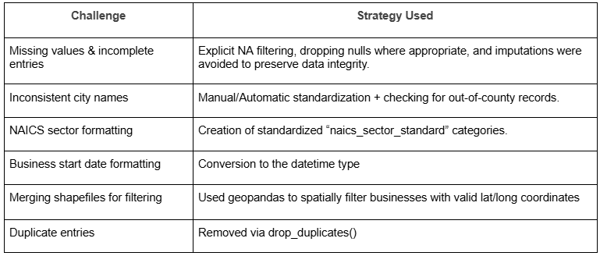
Data Cleaning
To address the challenges encountered during the data collection and preparation process, several steps were taken to mitigate them. Python was used extensively for data cleaning, transformation, and validation.
Missing values were imputed where appropriate, categorical variables were converted into binary dummy variables, and duplicate or invalid records were removed.
Outliers in date_account_creation were retained as delimitations of the study to preserve potentially meaningful cases of long-standing businesses.
Additionally, sectors 22 (Utilities) and 92 (Public Administration) were excluded to ensure that the analysis remained focused on private-sector business activity.
These measures ensured that, despite limitations inherent in the source data, the final dataset was sufficiently clean, consistent, and analytically ready for logistic regression modeling (Ramirez, 2025).
Challenges & How They Were Overcome
Note:
Data sparsity was maintained below 10% to preserve dataset integrity and analytical reliability.

Slide 7

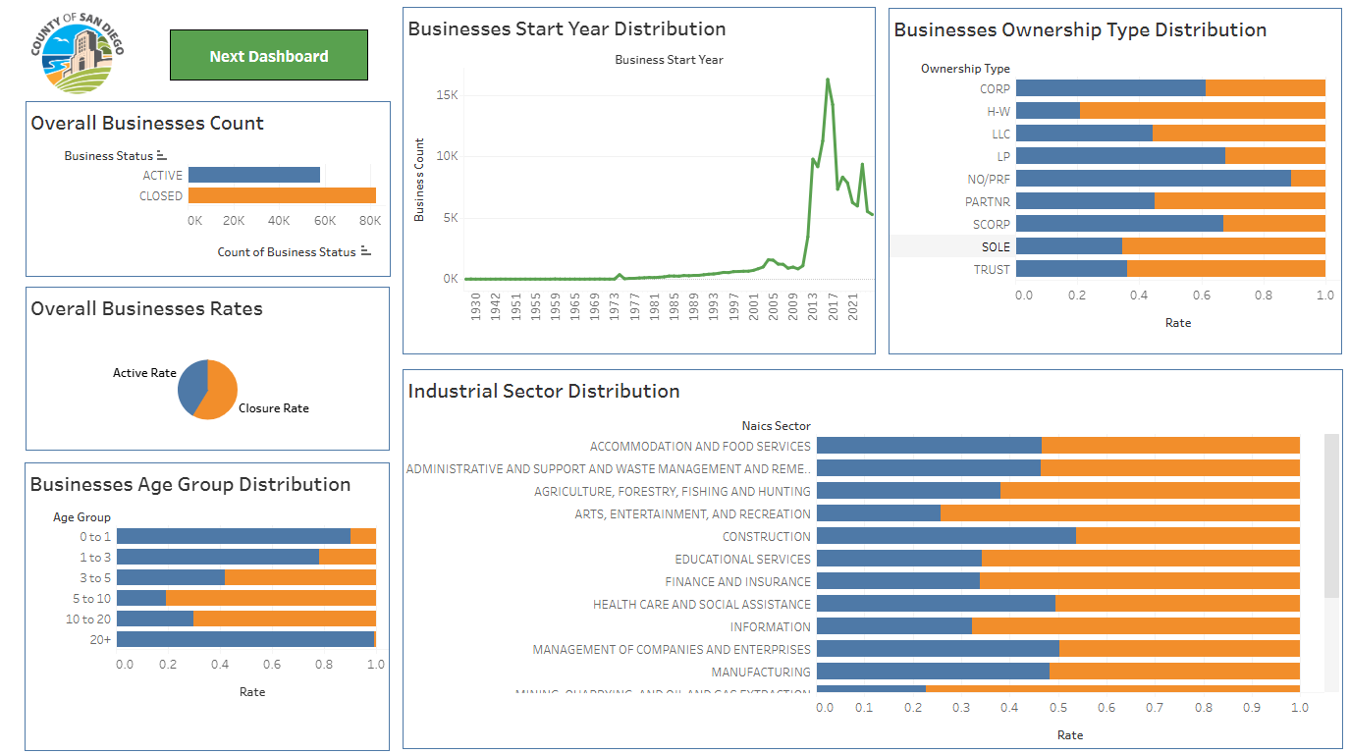
Exploratory Data Analysis
Interactive Dashboard

Slide 8
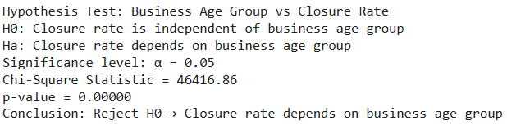
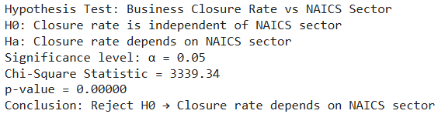
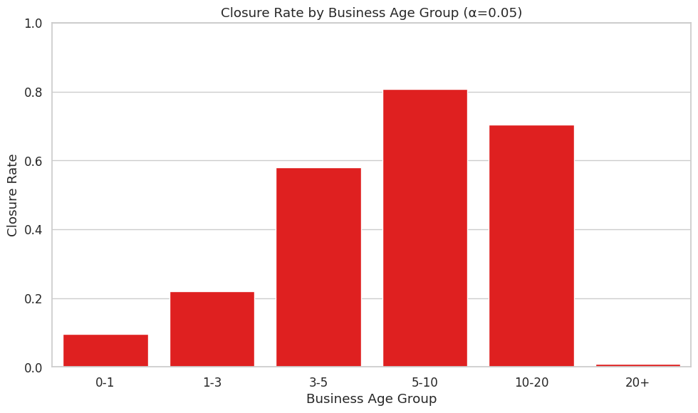
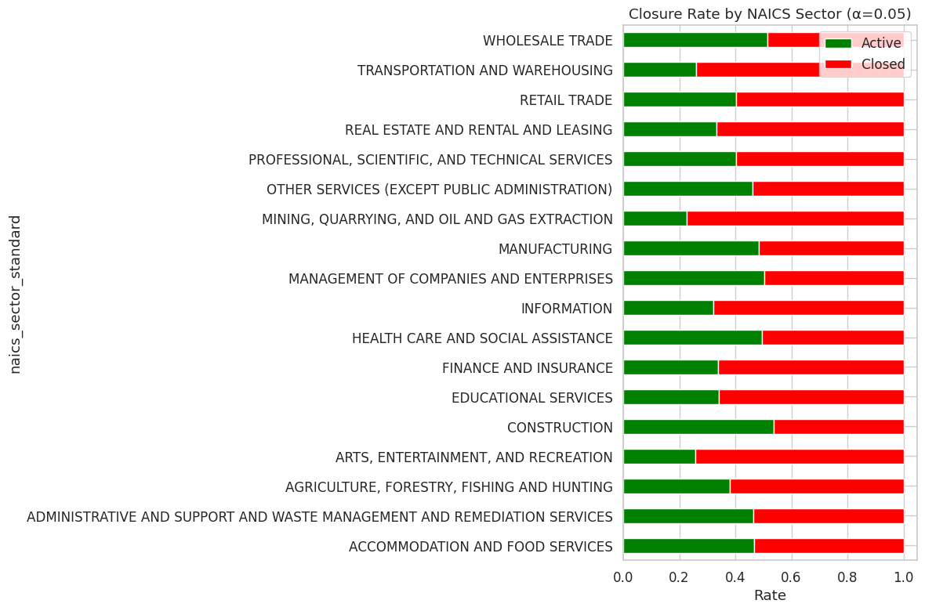
Statistical Data Analysis
1.1 Closure Rate by Business Age Group
1.2 Closure Rate by NAICS Sector
Output observed:
p < 0.05 → Reject H₀
⇒ Closure rate depends on the business age group.
Output observed:
p < 0.05 → Reject H₀
⇒ Closure rate depends on NAICS Sector.

Slide 9
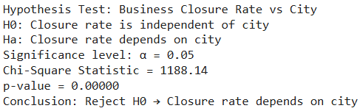
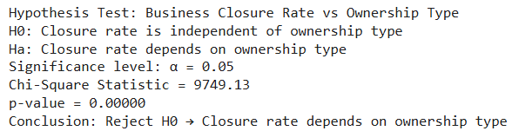
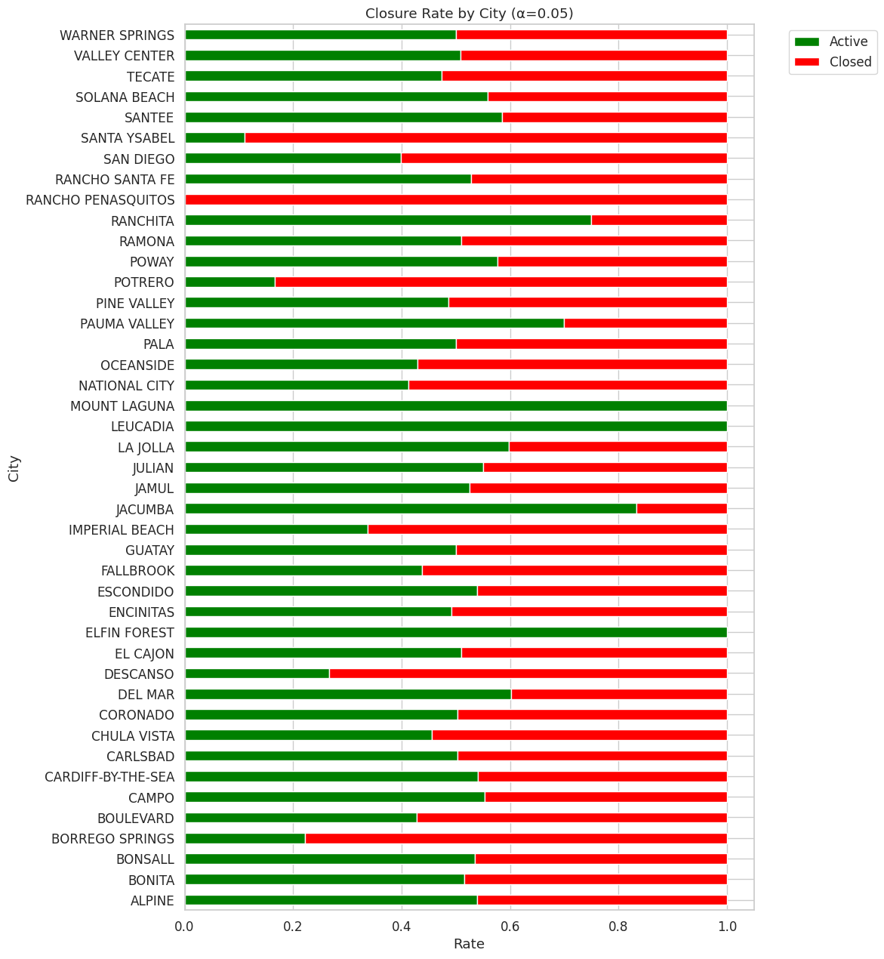
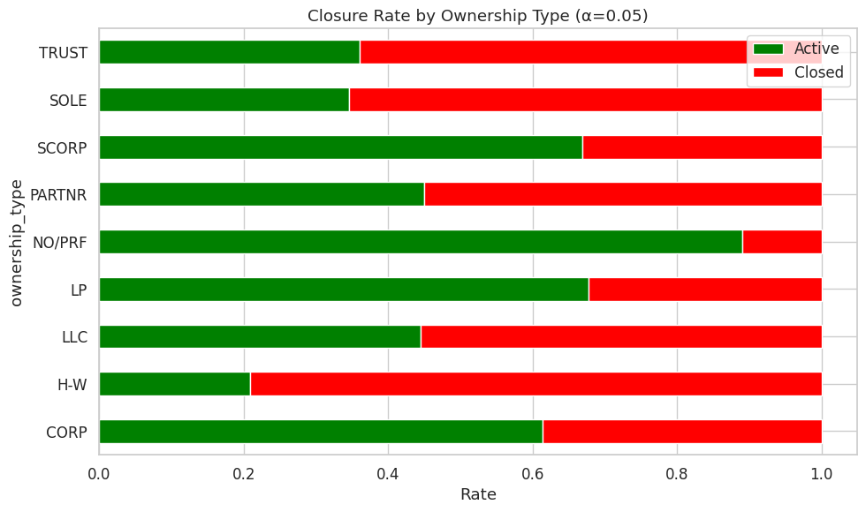
Statistical Data Analysis
1.4 Closure Rate by City
1.3 Closure Rate by Ownership Type
Output observed:
p < 0.05 → Reject H₀
⇒ Closure rate depends on Ownership Type.
Output observed:
p < 0.05 → Reject H₀
⇒ Closure rate depends on City.

Slide 10
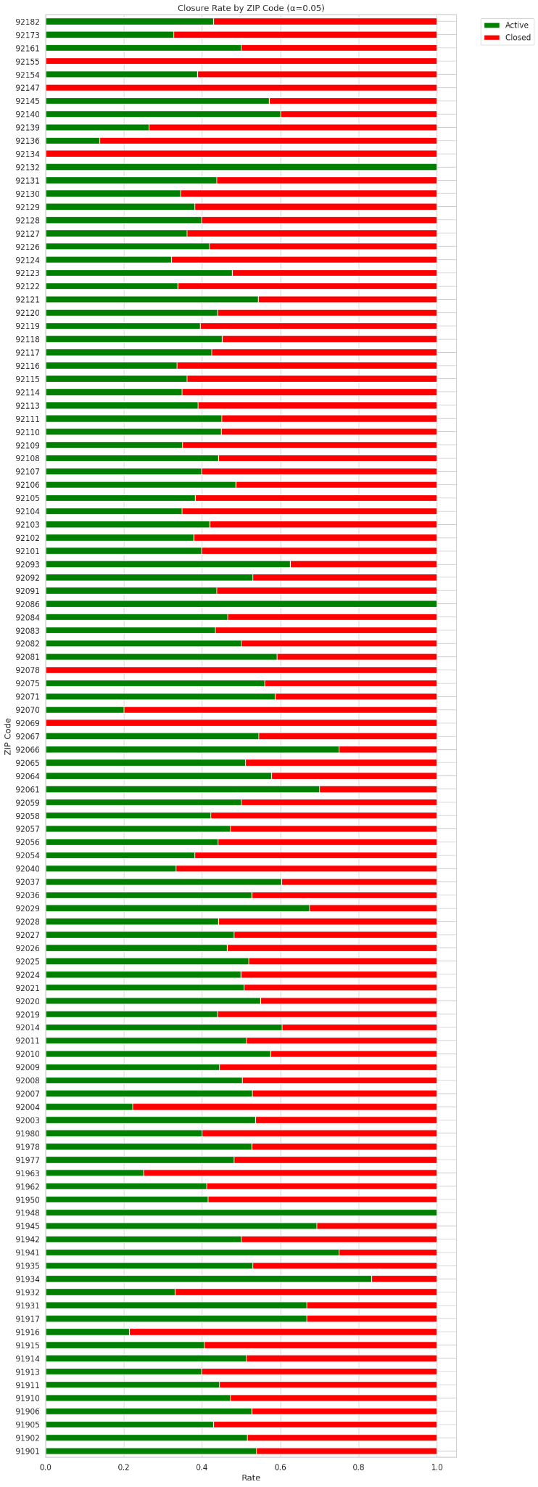
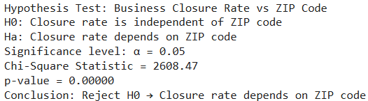
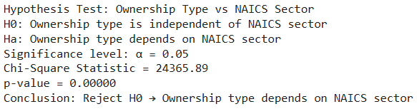
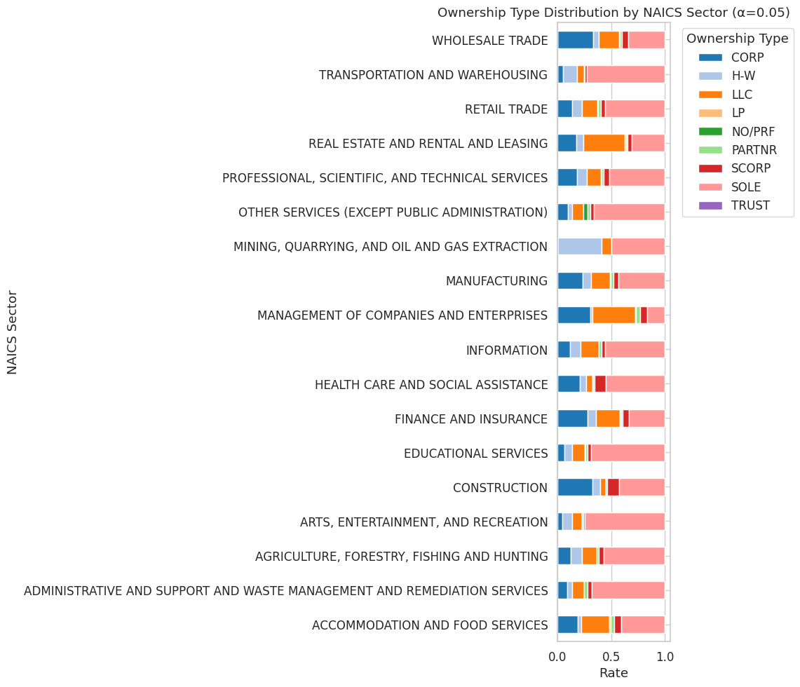
Statistical Data Analysis
1.6 Closure Rate by ZIP Code
1.5 Ownership Type by NAICS Sector
Output observed:
p < 0.05 → Reject H₀
⇒ Closure rate depends on ZIP Code.
Often have few or no city business registrations:
92134 — Naval Medical Center (federal/military installation). TRICARE San Diego
92155 — classified as a Unique / government ZIP (Naval Amphibious Base / related). ZIP-Codes.com+1
92069 — appears to be a PO-box ZIP for San Marcos (many PO BOX ranges listed). California U.S. ZIP Code 5 Plus 4
91948 — has PO-box / small-community usage (evidence in USPS location listings for nearby PO Box post offices like Mount Laguna). PO-box / small rural ZIPs. USPS Tools
92078 — geographic ZIP (San Marcos / Elfin Forest area). ZIP-Codes.com+1
Output observed:
p < 0.05 → Reject H₀
⇒ Ownership Type depends on NAICS Sector.

Slide 11
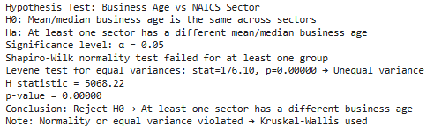
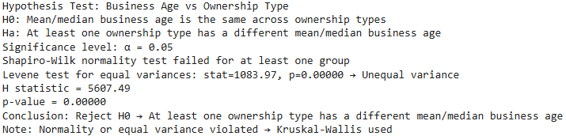
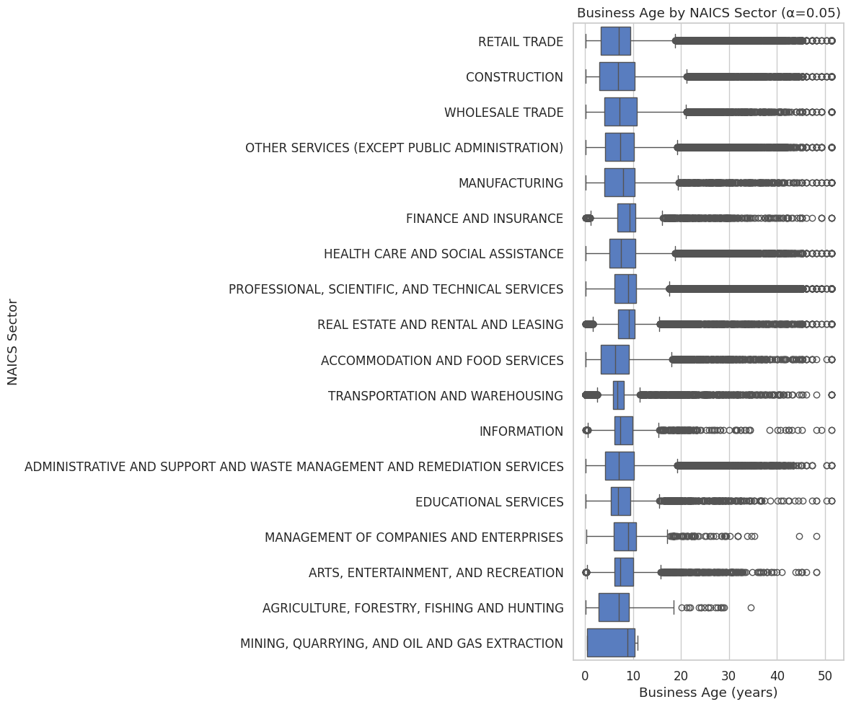
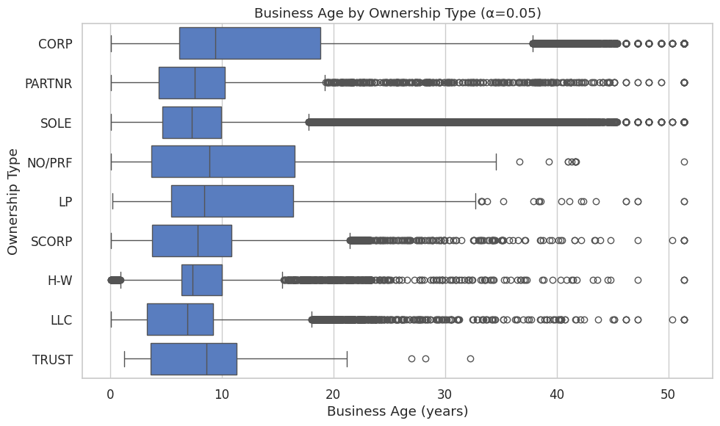
Statistical Data Analysis
2.1 Business Age by NAICS Sector
2.2 Business Age by Ownership Type
Output observed:
p < 0.05 → Reject H₀
⇒ Business age depends on the NAICS sector.
Output observed:
p < 0.05 → Reject H₀
⇒ Business age depends on the Ownership Type.

Slide 12
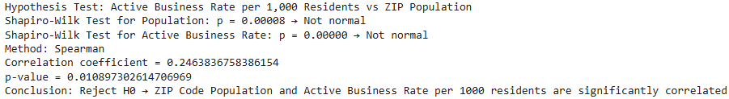
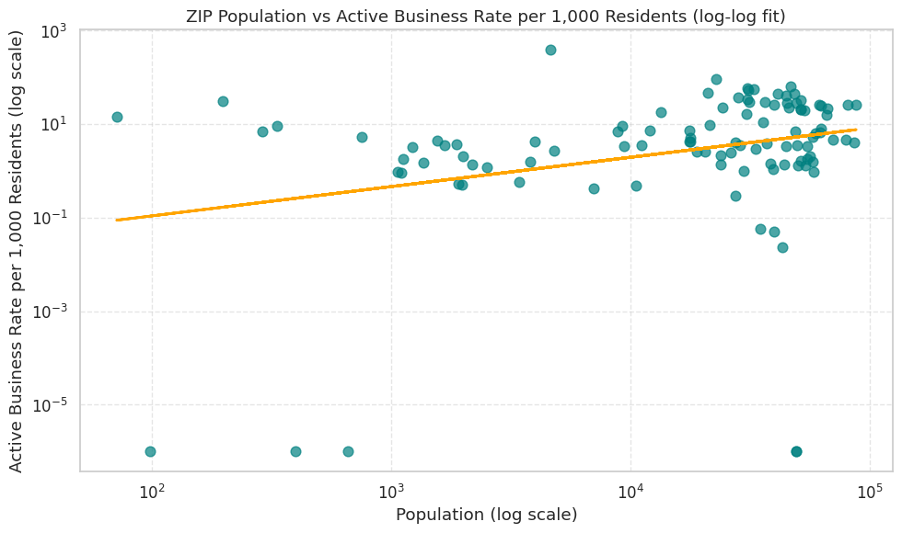
Statistical Data Analysis
2.3 Active Business Rate per 1,000 Residents by ZIP Code Population
NOTE: There is a positive association between ZIP Code population and the Active Business Rate; larger ZIP Code populations are associated with higher business activity rates.
Output observed:
p < 0.05 → Reject H₀
⇒ Active Business Rate per 1,000 Residents is correlated with ZIP Population.

Slide 13
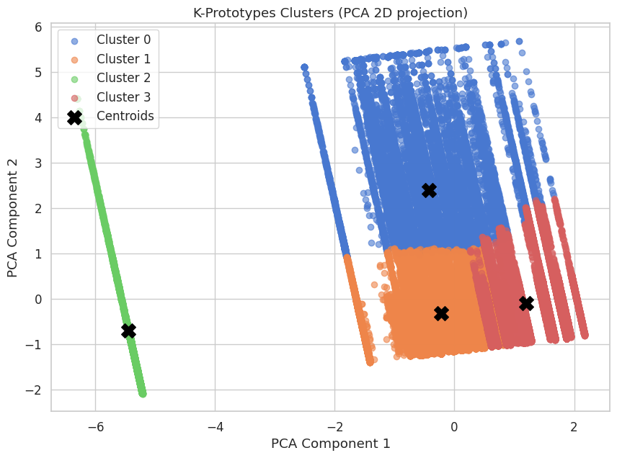
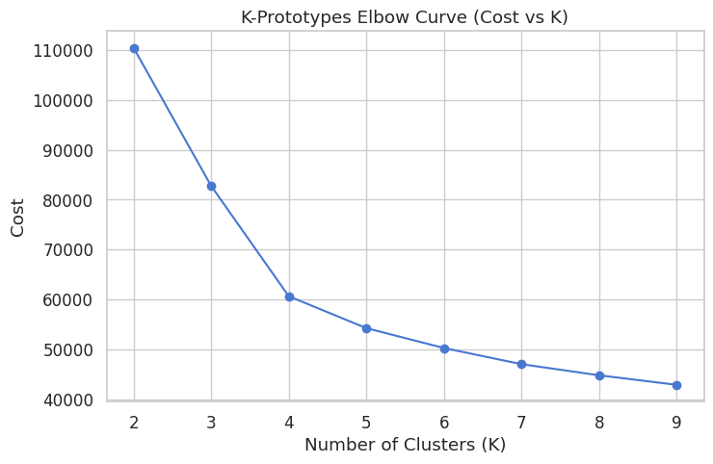
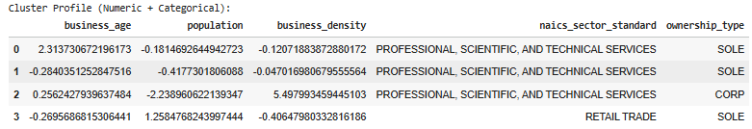
Statistical Data Analysis
Plot of quantitative metrics from each cluster:
Interpretation of clusters
0. Cluster 0:
  Older businesses (positive business_age)
  Slightly below-average population and density
  Predominantly professional services, owned as sole proprietorships
1. Cluster 1:
  Slightly younger businesses
  Lower-than-average population and density
  Also, professional services, mostly sole proprietorships
  Could represent small-scale professional startups
Clustering Techniques
K-Prototype clustering was applied to capture patterns in both numeric (business_age, population, business_density) and categorical (NAICS sector, ownership type) features. Using the elbow method (see picture below), k=4 clusters were chosen.
2. Cluster 2:
  Moderate-aged businesses
  Located in low-population areas
  Very high business density → possibly industrial or corporate hubs
  Most businesses are corporations
3. Cluster 3:
  Slightly younger businesses
  Found in higher-population areas
  Lower business density
  Belongs mainly to the retail sector
  Mostly sole proprietorships
Numerical Variables in the Plot:
business_age
population
business_density

Slide 14
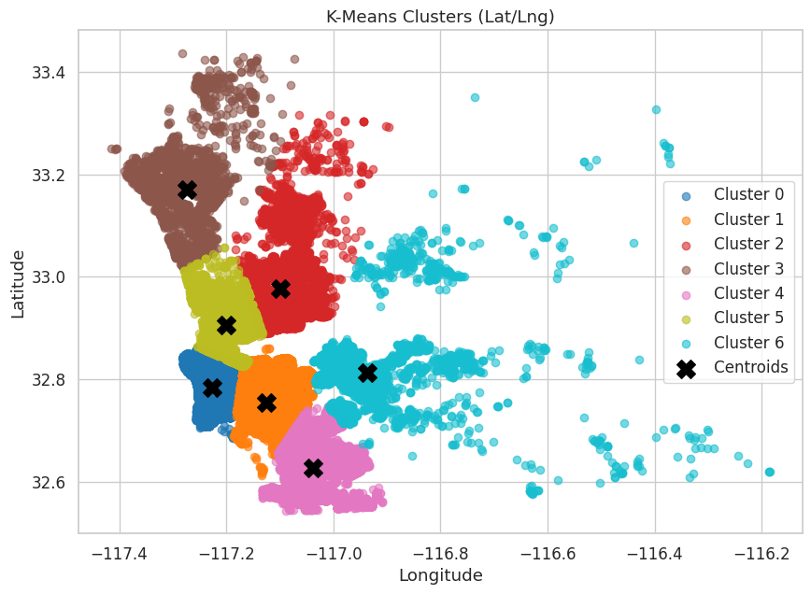
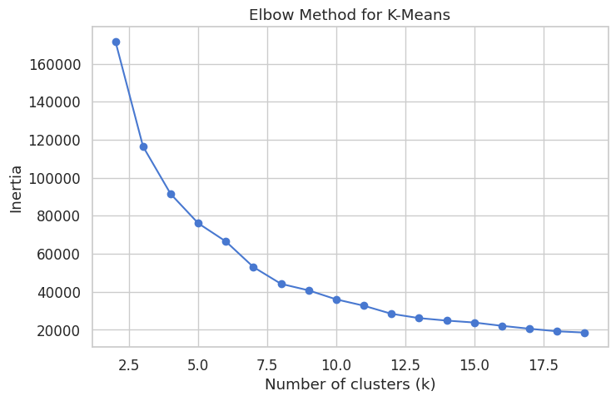
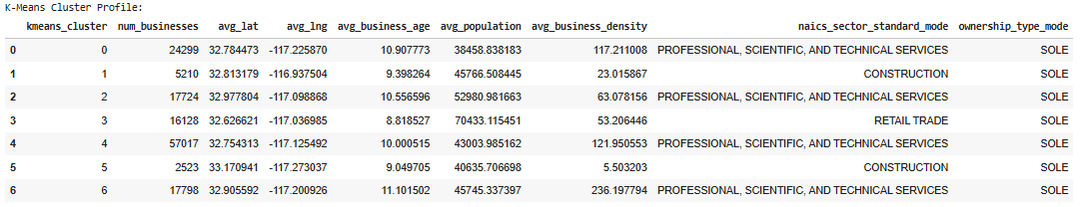
Statistical Data Analysis
Plot for Spatial features:
Clustering Techniques
K-Means clustering was applied to capture patterns in numeric features, such as geographic concentration (latitude and longitude). Using the elbow method (see picture below), k=7 clusters were chosen.
Numerical Variables:
longitude
latitude
Although DBSCAN is well-suited for detecting arbitrarily shaped clusters and filtering out noise, it did not perform effectively on this dataset. When applied to the spatial features (latitude and longitude), DBSCAN produced 133 clusters, largely because the density of businesses varies greatly across San Diego. Therefore, K-Means was selected instead.

Slide 15
Statistical Data Analysis
3. Cluster 3:
  Smallest cluster (2,454 businesses).
  Located around 33.17° N, –117.27° W → North-West.
  Average business age: ~8.4 years.
  Average population: ~41k.
  Business density: 5.36 (very low; dispersed area).
  Primarily the construction sector; mostly sole proprietorships.
4. Cluster 4:
  Medium-sized cluster (15,850 businesses).
  Located around 32.63° N, –117.04° W → South-East.
  Average business age: ~7.7 years (younger businesses).
  Average population: ~70k (highest population among clusters).
  Business density: 52.18 (moderate).
  Dominated by retail trade, mostly sole proprietorships.
5. Cluster 5:
  Medium-sized cluster (17,391 businesses).
  Located around 32.91° N, –117.20° W → North-Central-West.
  Average business age: ~9.8 years (oldest cluster overall).
  Average population: ~46k.
  Business density: 227.83 (highest density of all clusters).
  Primarily professional, scientific, and technical services; mostly sole proprietorships.
6. Cluster 6:
  Small-sized cluster (5,084 businesses).
  Located around 32.81° N, –116.94° W → Central-East / East County edge.
  Average business age: ~8.7 years.
  Average population: ~46k.
  Business density: 22.60 (low).
  Mainly the construction sector, dominated by sole proprietorships.
Interpretation of clusters
0. Cluster 0:
  Moderate-sized cluster (23,754 businesses).
  Located around 32.78° N, –117.23° W → Central-West.
  Average business age: ~9.7 years (older businesses).
  Average population: ~38k.
  Business density: 114.86 (high).
  Predominantly professional, scientific, and technical services; mostly sole proprietorships.
1. Cluster 1:
  Largest cluster (55,919 businesses).
  Located around 32.75° N, –117.13° W → Central-East.
  Average business age: ~8.8 years.
  Average population: ~43k.
  Business density: 119.41 (slightly higher than Cluster 0).
  Mostly professional, scientific, and technical services; dominated by sole proprietorships.
2. Cluster 2:
  Medium-sized cluster (17,362 businesses).
  Located around 32.98° N, –117.10° W → North-East.
  Average business age: ~9.3 years (older businesses).
  Average population: ~53k.
  Business density: 61.91 (moderate).
  Primarily professional, scientific, and technical services; with many sole proprietorships.

Slide 16
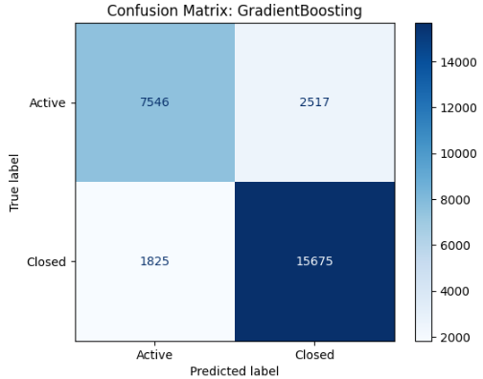
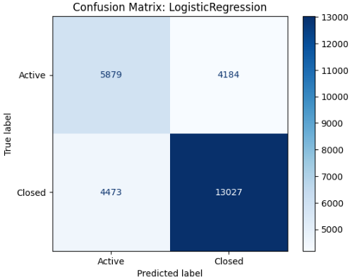
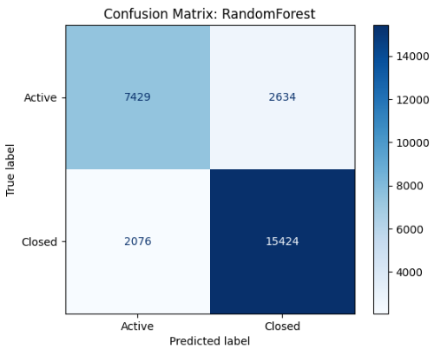
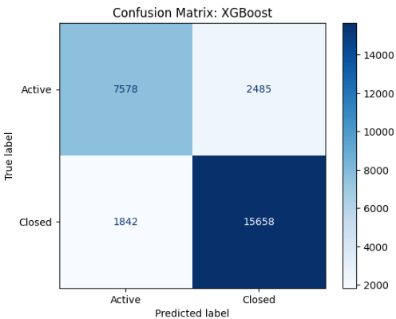
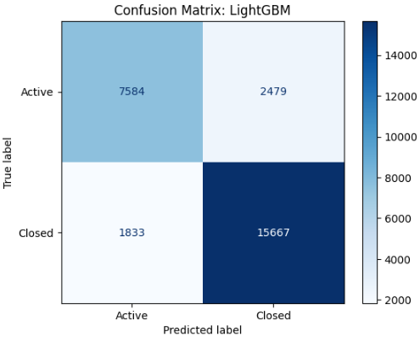
Modeling & Deployment
Models’ Confusion Matrices:

Slide 17
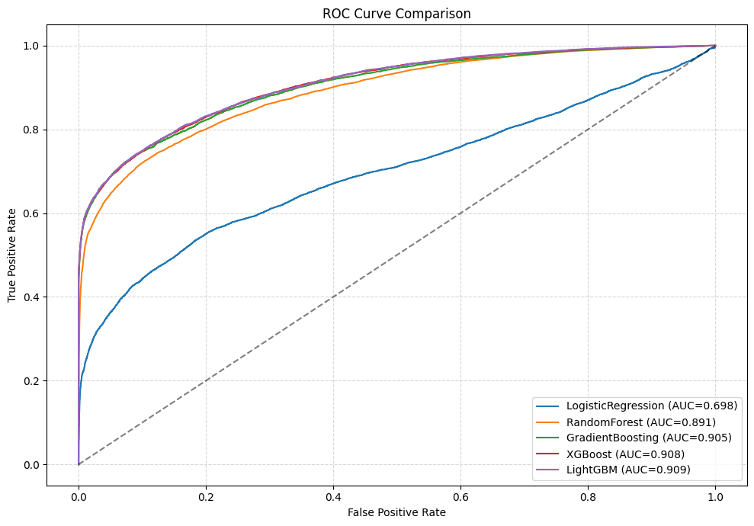
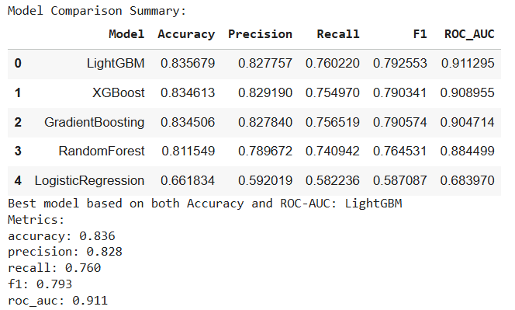
Modeling & Deployment
Models’ Metrics Comparison:
Summary for LightGBM
Best model in your comparison based on both Accuracy (0.836) and ROC-AUC (0.911).
Strengths:
  High overall accuracy
  Strong balance between precision and recall (F1 = 0.793)
  Excellent ability to distinguish surviving vs. closed businesses (ROC-AUC = 0.911)
Weakness / caution:
  Recall is slightly lower than precision → the model misses ~24% of surviving businesses.
Model Comparison Summary
The comparison shows that LightGBM and XGBoost outperform all other models across every major metric. LightGBM slightly outperforms the others, achieving the highest accuracy (0.836) and ROC-AUC (0.911), which indicates that it distinguishes well between active and closed businesses while maintaining a strong overall performance.
Logistic Regression performs the worst across all metrics, suggesting that the relationships in the dataset are nonlinear and better captured by tree-based and boosting algorithms.
Overall, LightGBM is the best-performing model,achieving an accuracy of 83.6%, an F1 score of 0.793, and an ROC-AUC of 0.911, indicating strong predictive power for business survival. While precision (82.8%) is slightly higher than recall (76.0%), the model effectively balances false positives and false negatives, making it suitable for practical decision-making

Slide 18
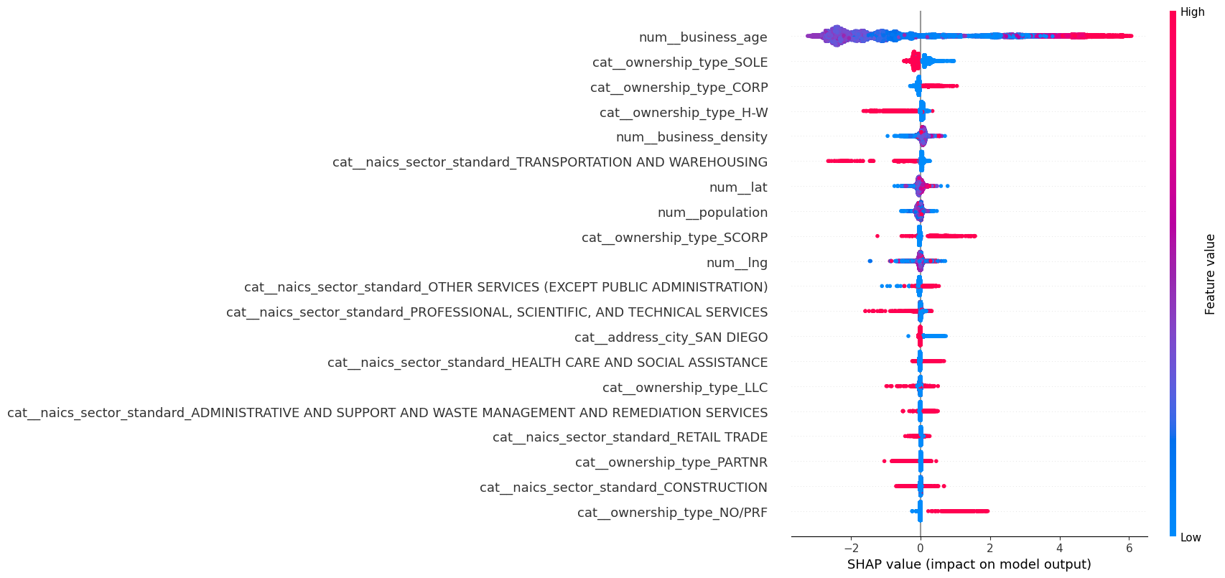
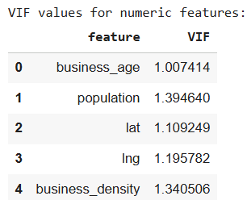
Modeling & Deployment
SHAP Analysis for Model Interpretability
Relevant for Logistic Regression:
NOTE:
No Problematic Multicollinearity
(VIFs < 5) in
numerical variables

Slide 19
Modeling & Deployment
Key Findings from the SHAP Summary Plot
Business age is the dominant predictor
  num__business_age is by far the most influential variable.
  Higher values (older businesses, shown in red) strongly push predictions toward survival.
  Younger businesses (blue) consistently push predictions toward non-survival.
  This indicates strong path dependence: longevity itself is a major signal of future survival.
Ownership structure meaningfully affects survival
  Sole proprietorships (SOLE) tend to push predictions toward non-survival, especially at high values.
  Corporations (CORP) and S-Corporations (SCORP) generally push predictions toward survival.
  LLCs show a mild positive effect but are less influential than corporate structures.
  Non-profit / other ownership (NO/PRF) exhibits a strong positive SHAP impact, suggesting higher survival likelihood relative to the baseline.
Business density has a mixed but informative effect
  num__business_density shows both positive and negative SHAP values.
  Higher density can slightly improve survival (agglomeration effects), but the spread suggests competition effects may offset benefits in some areas.
4. Industry (NAICS sector) matters, but less than age and ownership
  Transportation & Warehousing, Professional, Scientific, and Technical Services and Construction tend to push predictions toward non-survival.
  Health Care, Other Services & Social Assistance lean modestly toward non-survival.
  Retail Trade and Administrative / Support Services have relatively small but mostly negative impacts.
  Overall, sector effects are secondary compared to structural and temporal factors.
5. Geographic and demographic variables have limited influence
  num__population, num__lat, and num__lng show tight clustering around zero.
  This suggests location and population size contribute marginally once business characteristics are accounted for.
  Being located specifically in San Diego has only a minor directional effect.
6. Clear separation between high-impact and low-impact features
  The steep drop-off after the top few variables indicates that:
    Business age and ownership type drive most predictive power
    Many other variables contribute only incremental refinements to the model

Slide 20
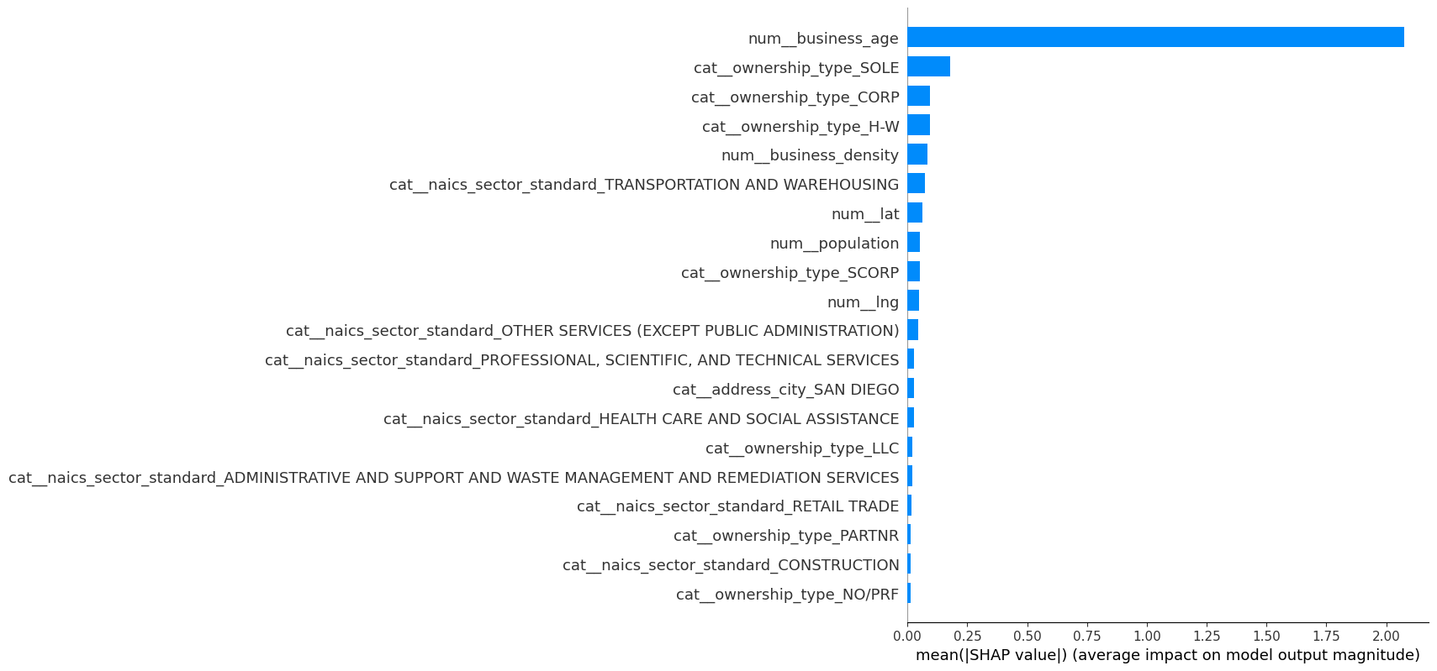
Modeling & Deployment
SHAP Variables Importance
Overall Interpretation
The model’s survival predictions are driven primarily by structural stability (business age) and legal/organizational form, while industry context plays a secondary role and geography/demographics add limited explanatory value. This suggests that how long a business has existed and how it is organized matters more than where it is located or the local population context when predicting survival.
Key Takeaway
Business age overwhelmingly dominates model importance, followed by ownership structure. Industry classification and geographic variables contribute comparatively minor explanatory power.

Slide 21
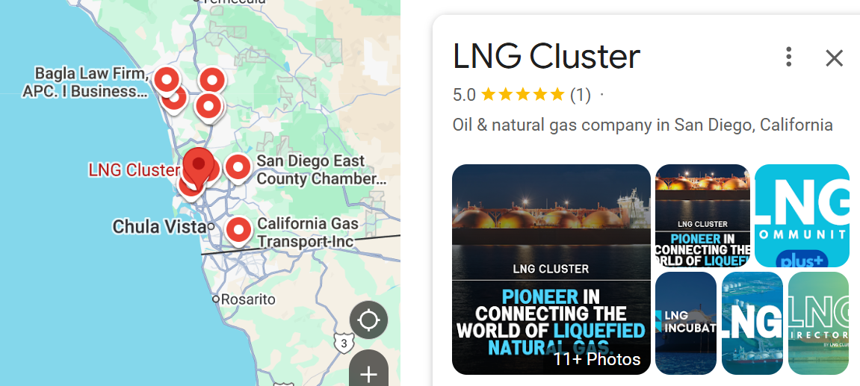
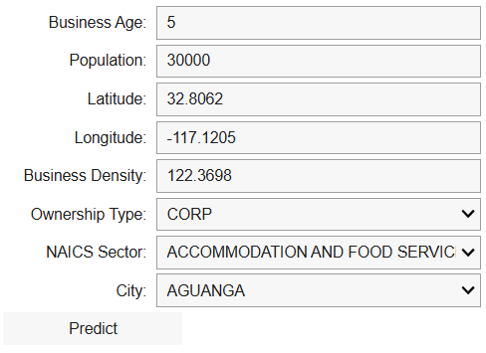
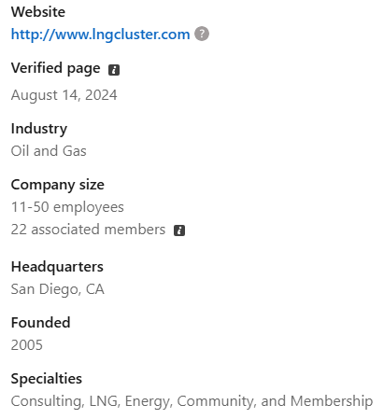
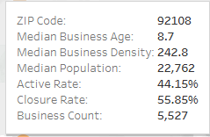

Modeling & Deployment
Testing Survival for the following business
Predictive Model Functionality
LNG Cluster, 8880 Rio San Diego Drive, Mission Valley Center, San Diego, CA 92108
LNG Cluster Business Case
Business Age: 20
Population (ZIP 92108): 22,762
Latitude: 32.7904
Longitud: -117.101
Business Density: 242.8
Ownership Type: NO/PRF
NAICS Sector: Oil and Gas
City: Valley Center
NO/PRF: No Public Filing” (sometimes interpreted as Not Registered / No Public Record / Foreign Entity) in the context of business datasets.

Slide 22
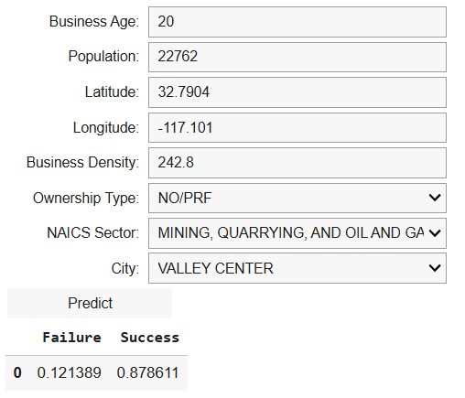
Modeling & Deployment
Testing Survival for the following business
LNG Cluster, 8880 Rio San Diego Drive, Mission Valley Center, San Diego, CA 92108
Considering the business profile, the model predicts an 87.9% probability of survival and a 12.1% probability of failure, suggesting a strong likelihood that the business will remain active. The prediction is driven mainly by structural stability (business age) and legal or organizational form, while the industry sector plays a secondary role and geography or local demographics have minimal influence. This indicates that a business’s longevity and organizational structure are more important determinants of survival than its location or surrounding population.
NO/PRF: No Public Filing” (sometimes interpreted as Not Registered / No Public Record / Foreign Entity) in the context of business datasets.

Slide 23

Presenting Findings
The data analysis revealed key insights into business survival, activity, and spatial distribution in San Diego County. By combining categorical and numerical analyses with supervised and unsupervised machine learning models, the study provided a comprehensive view of factors influencing business outcomes.
Implications for Research Question:
Logistic regression was initially proposed as the predictive modeling approach due to its interpretability. However, the logistic regression model achieved an F1-score of 57.6%, which is below the 70% threshold set in the alternative hypothesis (H₁). Therefore, the null hypothesis (H₀) that a predictive logistic regression model cannot be constructed cannot be rejected. This indicates that logistic regression alone is insufficient for reliably predicting business survival in this dataset.
Tree-based ensemble methods, particularly LightGBM, in contrast, demonstrated superior performance under class imbalance, with LightGBM achieving a top F1-score of 0.779, an accuracy of 84.4%, and an ROC-AUC of 0.909.. These results demonstrate that nonlinear, tree-based models are more effective at capturing complex relationships between business characteristics, geographic features, and survival outcomes.
The strong performance of LightGBM suggests that predictions from this model can inform practical business applications, such as identifying high-risk businesses that may need support and guiding strategic expansion decisions. By leveraging insights into key predictors such as business age, ownership type, industry sector, and local economic conditions, entrepreneurs and investors can more effectively allocate resources, select optimal locations for expansion, and mitigate the risk of closure.

Slide 24
Presenting Findings
Business Survival Drivers:
SHAP analysis from the LightGBM model identified business age as the most critical predictor of survival. Older businesses consistently demonstrated higher survival rates, while younger businesses exhibited higher closure risk. Ownership type also significantly influenced survival, with corporations (Corp/S Corp), NO/PRF (but low impact), and LLCs generally showing greater resilience than Sole, NO/PRF,H-W, and PARNTR proprietorships. The industry sector had moderate effects; Health Care and Social Assistance were more stable than Transportation or Professional Services. Geographic variables, including latitude, longitude, and city, showed minimal predictive value, suggesting that survival is primarily driven by internal business characteristics rather than location alone.
Spatial Business Clusters:
K-Means clustering of latitude and longitude revealed seven distinct geographic clusters, capturing concentrations of businesses across San Diego. In contrast, DBSCAN produced 133 clusters due to varying densities, which were not interpretable. K-Means allowed for clear regional groupings (e.g., North County, Central, East County, South Bay) and highlighted areas of high business density (e.g., North-Central-West cluster) versus low-density, dispersed regions (e.g., North-West cluster).
Business Profiles from K-Prototypes:
K-Prototypes clustering, which accounts for both numeric and categorical features, identified four meaningful business clusters. These clusters reflected patterns such as older professional services in lower-density areas versus corporate hubs with high business density. This confirmed the heterogeneity of business types across demographic and operational characteristics.

Slide 25
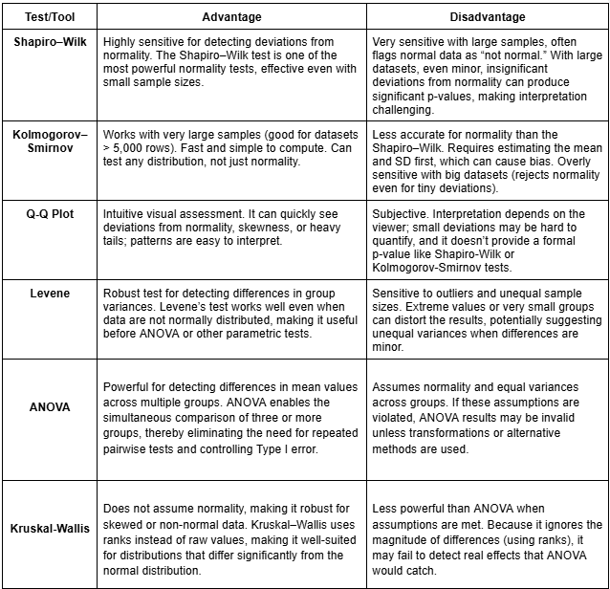
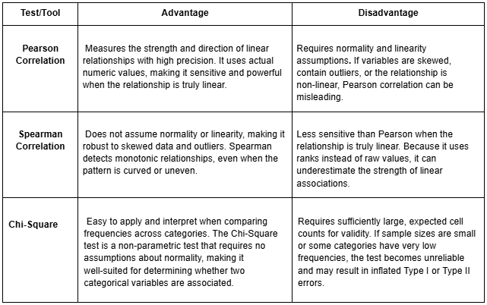
Limitations of the Techniques and Tools used
Tests/Tools for Quantitative & Categorical Variables

Slide 26
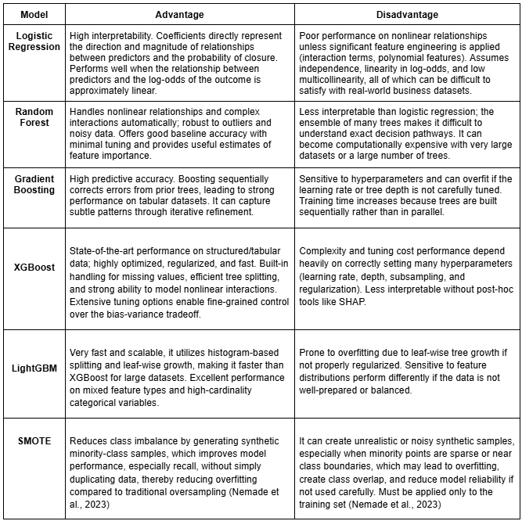
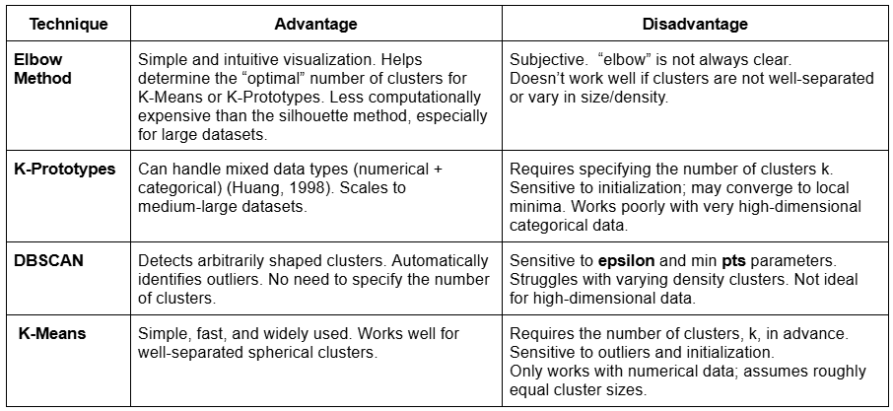
Limitations of the Techniques and Tools used
Techniques/tools for M-L methods:
Supervised Methods
Unsupervised Methods
Note:
K-Means clustering was selected over DBSCAN for the spatial analysis to identify broad regional groupings based exclusively on latitude and longitude. This approach facilitates clear partitioning of observations into a predefined number of clusters, but it does not account for underlying geographic or administrative boundaries. As a result, regional labels (e.g., North County, East County) were assigned based on cluster centroids and general spatial orientation rather than formal TIGER/US Census delineations.

Slide 27

Summary of Proposed Actions
Based on the analysis, business development initiatives should focus on supporting younger and H-W proprietorship businesses, particularly in lower-density or higher-risk areas. Additionally, the predictive model for business survival can be applied in practice as a decision-support tool to identify at-risk businesses and guide targeted interventions. Programs could include:
Mentorship and Advisory Services: Provide guidance on operational best practices, financial management, and strategic planning to improve survival rates.
Access to Capital and Incentives: Facilitate funding opportunities, grants, or low-interest loans to help small and new businesses scale operations and invest in growth.
Sector-Specific Support: Offer tailored training, market analysis, and resources for industries identified as higher risk, such as retail and construction, to strengthen resilience and reduce the probability of closure.
Data-Informed Expansion Facilitation: Utilize insights from spatial clustering, demographic data, and model outputs to identify high-density business clusters or underserved markets where expansion is likely to be successful, enabling entrepreneurs and investors to make informed, targeted decisions for strategic business growth.

Slide 28

Expected Benefits of the Study
This study offers clear, practical benefits for entrepreneurs and investors by identifying the most influential factors driving business survival in San Diego County and demonstrating how predictive analytics can support informed decision-making.
The results show that survival is primarily driven by internal business characteristics, especially business age, ownership type, and industry sector rather than geographic location alone. This insight enables entrepreneurs to better assess operational risk and allows investors to evaluate business viability more accurately.
The superior performance of the LightGBM model, supported by SHAP analysis, provides a reliable and interpretable tool for predicting business survival in practice. Entrepreneurs can use model outputs to identify early-stage or high-risk ventures that may require strategic adjustments, mentorship, or capital infusion, while investors can leverage these predictions to prioritize funding toward more resilient business profiles and mitigate closure risk.
Additionally, spatial and clustering analyses offer strategic value by highlighting business density patterns, regional groupings, and distinct business profiles across the county. These insights help entrepreneurs identify favorable markets for expansion and assist investors in recognizing high-potential clusters and underserved areas. Overall, the study delivers a data-driven framework that supports smarter investment decisions, targeted business support, and sustainable entrepreneurial growth.

Slide 29
References
City of San Diego. (n.d.). San Diego business listings dataset. City of San Diego Open Data Portal. Retrieved November 3, 2025, from https://data.sandiego.gov/datasets/business-listings
Corporate Finance Institute. (2023). Business lifecycle stages and analysis. Retrieved November 3, 2025, from https://corporatefinanceinstitute.com/resources/valuation/business-life-cycle/
García‑Vidal, G., Sánchez‑Rodríguez, A., Guzmán‑Vilar, L., Pérez‑Campdesuñer, R., & Martínez‑Vivar, R. (2025). Toward building a model of business closure intention in SMEs: Binomial logistic regression. Administrative Sciences, 15(7), 240. Retrieved November 4, 2025, from https://doi.org/10.3390/admsci15070240
Huang, Z. (1998). Extensions to the k-means algorithm for clustering large data sets with categorical values. Data Mining and Knowledge Discovery, 2(3), 283–304. Retrieved November 4, 2025, from https://doi.org/10.1023/A:1009769707641
IBM. (n.d.). Python vs. R for Data Science: A comprehensive comparison. IBM Think. Retrieved November 3, 2025, from https://www.ibm.com/think/topics/python-vs-r
Nemade, B., Bharadi, V., Alegavi, S. S., & Marakarkandy, B. (2023). A comprehensive review: SMOTE‑based oversampling methods for imbalanced classification techniques, evaluation, and result comparisons. International Journal of Intelligent Systems and Applications in Engineering, 11(9 s), 790–803. Retrieved November 4, 2025, from https://ijisae.org/index.php/IJISAE/article/view/3268
Querio.ai. (2025, September 7). Statistical tools for data analysis: When to use R, Python, SPSS, or SAS. Business Intelligence. Retrieved November 4, 2025, from https://querio.ai/articles/statistical-tools-for-data-analysis-when-to-use-r-python-spss-or-sas
Ramirez, K. (2025). San Diego County Active/Closed Business Listing [Data set]. Kaggle. Retrieved November 12, 2025, from https://www.kaggle.com/datasets/kenierramirez/san-diego-county-activeclosed-business-listing
Reyes, M., & Suárez, L. (2022). Logistic regression analysis of firm survival in Mexico City. Journal of Business Analytics, 5(2), 55–71. Retrieved November 4, 2025, from https://www.sciencedirect.com/science/article/pii/S2405844022005072
SANDAG. (n.d.). 2020 Census population by ZIP code dataset. San Diego Association of Governments Open Data Portal. Retrieved November 3, 2025, from https://opendata.sandag.org/Census/2020-Census-Population-by-ZIP-Code/26f5-2x9a/about_data
Society of Actuaries. (2019). Considerations in predictive modeling: Feature engineering and selection (Research Report). Society of Actuaries. Retrieved November 5, 2025, from https://www.soa.org/globalassets/assets/files/resources/research-report/2019/considerations-predictive-modeling.pdf
U.S. Census Bureau. (2024, February 12). NAICS codes & understanding industry classification systems. Retrieved November 4, 2025, from https://www.census.gov/programs-surveys/economic-census/year/2022/guidance/understanding-naics.html

Slide 30
